Slide 1
IFB FQ15096
SUPPLY, DELIVERY, AND INSTALLATION OF THE PORTABLE JACKS
Presented : Pre-Bid Conference
March 25, 2015
1

Slide 2
IFB FQ15096 SUPPLY, DELIVERY, AND INSTALLATION OF THE PORTABLE JACKS
PROJECT OVERVIEW
Supply, install, interconnect, program, calibrate, synchronize and test
- Two (2) set of 8 ea., 20 metric tons capacity mobile lifting jacks
- A control panel in each of the 2 sets, to synchronize the operation of the eight (8) jacks
- One (1) set of 4 ea., 20 metric tons capacity mobile lifting jacks that can be used as spare jacks (excluding the control panel)

Slide 3
IFB FQ15096 SUPPLY, DELIVERY, AND INSTALLATION OF THE PORTABLE JACKS
Lifts shall meet the following requirements:
Lifting capacity per jack: | 20 tons
Lifting capacity per set of four jacks: | 80 tons
Lowest position of cantilever (claw) above upper edge of rail (floor): | 400 mm
Highest position of cantilever (claw) above upper edge of rail (floor): | not less than 1950mm
Vertical Stroke: | not less than 1565mm
Lifting/lowering speed: | 12 to16 inch per minute
Operating Voltage: | 480 V
Protection of electrical equipment: | IP 54 or higher
Synchronized precision for set | 4 mm or .16 in
Noise Level | < 70 db (A)
Documentation: | Two fold each: GA drawing, Spare Parts List, Wiring Diagram, Lubrication Plan, Operation and Maintenance manual. Refer to Deliverables section.
Coating: | Blast cleaning according to SIS 05 5900 Standard, SA grade 2-1/2. Color: Yellow, RAL 1007
Regulations: | EN 1493, ISO Standard, DIN Standard, IEC Regulations, VDE Regulations, and OSHA

Slide 4
IFB FQ15096 SUPPLY, DELIVERY, AND INSTALLATION OF THE PORTABLE JACKS
Equipment | Amount
Mobile lifting jacks (Portable Jacks) | 16
Spares mobile lifting jacks (Portable Jacks) | 4
Control panels to synchronize the operation of eight (8) jacks | 2
Electrical requirements | Contractor to provide electrical cable and plugs type HBL460P7W necessary to operate all the Jacks. Reference Attachment A for electrical infrastructure existing in the Facility.

Slide 5
IFB FQ15096 SUPPLY, DELIVERY, AND INSTALLATION OF THE PORTABLE JACKS
Deliverables
OPERATION MANUALS AND MAINTENANCE MANUALS - (5) hard copies (inserted in binders) and one (1) electronic copy (pdf format) on the day of the delivery of the portable jacks. Two (2) of the Manuals shall have laminated or similarly protected pages throughout.
Shall include, but not limited to;
1. Equipment function, normal operating characteristics, limiting operations.
2. Demonstrate assembly, disassembly, and installation instructions of all equipment. Technical manuals shall include testing, troubleshooting charts with corrective action and scheduled maintenance instructions.
3. Operating instructions for start-up, routine and normal operation, regulation and control, shutdown, and emergency conditions.
4. Incorporate the equipment’s lubrication and maintenance instructions.
5. Parts list and predicted life of parts subject to wear.

Slide 6
IFB FQ15096 SUPPLY, DELIVERY, AND INSTALLATION OF THE PORTABLE JACKS
Shall include, but not limited to (cont.);
6. Outline, cross-section, and assembly drawings; engineering data; and electrical diagrams, including elementary diagrams, wiring diagrams, connection diagrams, word description of wiring diagrams and interconnection diagrams.
7. Test data and performance curves.
8. List of recommended spare parts with a price list and a list of spare parts provided under these specifications.
9. Copies of installation instructions, parts lists or other documents packed with equipment when delivered.
10. Product Technical Specifications.

Slide 7
IFB FQ15096 SUPPLY, DELIVERY, AND INSTALLATION OF THE PORTABLE JACKS
Performance and Acceptance Criteria
On-site training class in the operation of the jacks within a week after the delivery to the Yard.
Training shall include two sessions for two different shifts of a minimum duration of one day (7.5 hours) per each session (maximum of 16 students per session).
Provide presentation and materials (laptop computer, projector, etc.) to educate, train, and teach personnel enabling the staff to operate, service, and maintain the equipment satisfactorily. Training shall include on-site instructions, supplying twenty (20) handouts per session manuals, classroom aids, and all other items required to satisfactorily train personnel.
Practical training on equipment shall occupy a significant portion of all training classes.
At WMATA’s request, Training must also include a demonstration of the operation of the jacks by means of lifting a two (2) married pair train.

Slide 8
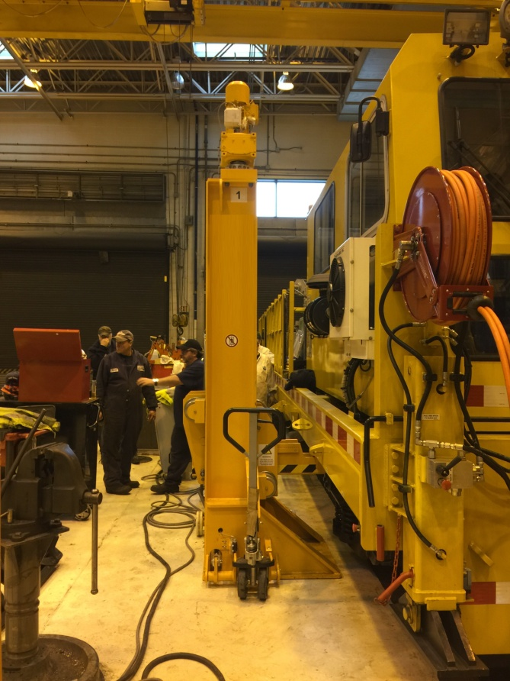
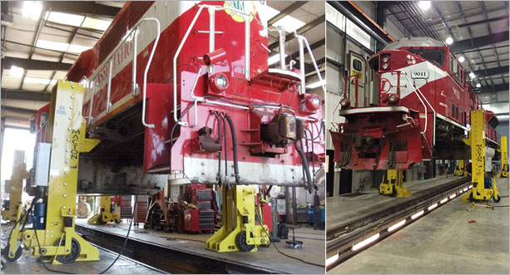
IFB FQ15096 SUPPLY, DELIVERY, AND INSTALLATION OF THE PORTABLE JACKS

